Slide 1
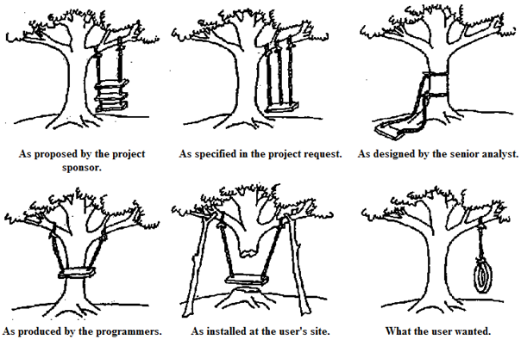
Quality Assurance
Quality in development process https://www.youtube.com/watch?v=y4B2Hv3HgpE

Slide 2
Quality and cost
Product features that meet customer needs
Higher quality enables companies to:
Increase customer satisfaction
Make products salable
Meet competition
Increase market share
Provide sales income
Secure premium prices
The major effect is on sales.
Usually, higher quality costs more.
Freedom from deficiencies
Higher quality enables companies to:
Reduce error rates
Reduce rework, waste
Reduce field failures, warranty charges
Reduce customer dissatisfaction
Reduce inspection, test
Shorten time to put new products on the market
Major effect is on costs.
Usually, higher quality costs less.
Juran's Quality Handbook

Slide 3
What is Quality
1. “Quality” means those features of products which meet customer needs and thereby provide customer satisfaction.
2. “Quality” means freedom from errors that require doing work over again (rework) or that result customer dissatisfaction.
Juran's Quality Handbook

Slide 4
Definitions
Product: The output of any process. Goods or services.
Product feature: A property prosessed by product to meet customer needs.
Customer: Anyone who is affected by the product.
Customer satisfaction: A state in which customers feel that their expectations have been met by the product features.
Deficiency: Any fault (defect, error) that impairs product’s fitness for use.
Customer dissatisfaction: A state in which deficiencies in product result in customer annoyance.

Slide 5
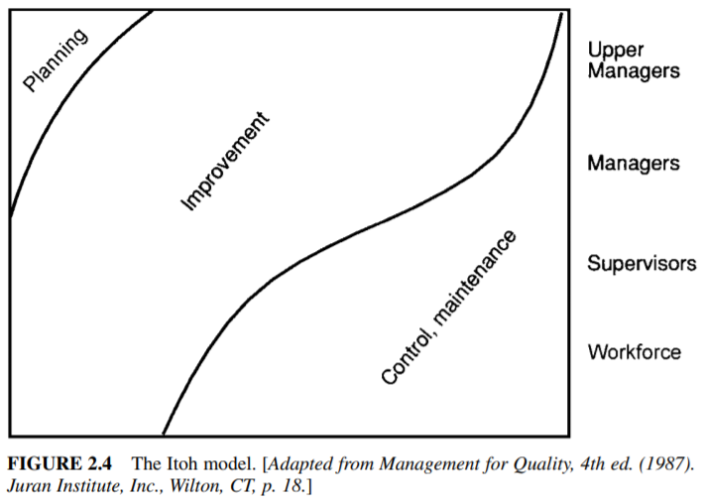
To Manage for Quality
Quality planning.
Quality control.
Quality improvement.

